Slide 1
Before we begin ...
Red Hat Contacts
Follow-up Sessions: John Riccitelli - jriccite@redhat.com
Technical Q&A: Marc Skinner - mskinner@redhat.com
Ansible Monthly Best Practice Session
Ansible Training via Red Hat Learning subscription
Ansible Optum Event Part II
September 9th - Ansible Collections
AnsibleFest - October 13-14th
https://www.ansible.com/ansiblefest

Slide 2

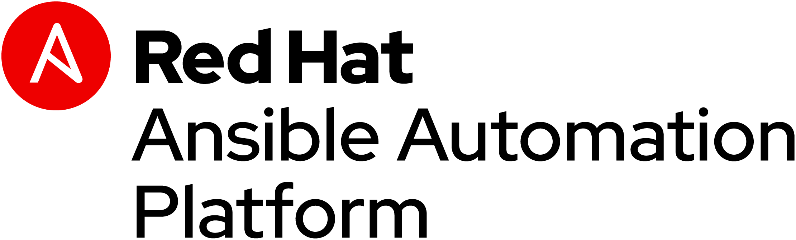
Automation for all
Ansible technical introduction and overview

Slide 3


Automation happens when one person meets a problem they never want to solve again
Notes:
We’re faced with numerous challenges in IT. You live them every day. Regardless of your role or responsibility.
Effort->time; time->money…
BUT Effort has a human toll.
In the end, we’re just people. People trying to work with other people, and force machines to do the work to be done.
Your reasons for automating are pretty straightforward. You’re tired of doing the same thing over and over again.
Automation makes our jobs and lives easier.
It presents an opportunity to do more.

Slide 4

Automated Security & HIPAA Compliance
Business Drivers
Industry standards based compliance - OpenSCAP, NIST, and HIPAA
Continuous scanning and remediation to remain in compliance with regulation; prevent cyber threats
Real time configuration and drift management
Simplify and speed up response to audits
AUTOMATED SECURITY & HIPAA COMPLIANCE
Technical Requirements
Consistent and verifiable enforcement policies
Compliance awareness and transparency
Reduced probability of human error and analysis time
Compliance-as-code
Simplified reporting
Automation
Red Hat Technology:
RHEL
Satellite
Insights
Ansible Automation
‹#›

Slide 5

Automation is happening in silos
Ansible used in silo
Developers
Is organic
automation enough?
DIY scripting automation
Security
Open source config management tool
Infrastructure
Proprietary vendor supplied automation
Network
Notes:
placeholder slide silo automaton versus holistic ansible != platform

Slide 6


When automation crosses teams, you need an automation platform
Network
Developers
Lines Of Business
Infrastructure
Security
Operations
A platform can help you:
Create, Scale, Engage, Reduce Risk
Notes:
We are enabling the different roles in the organization to work together.
** make your automation journey easy. Aligning the the different roles of the organization together to embrace automation across the org
Stop automating in silos
All contribute to network automation and work together to build the automation for the enterprise and individual use case
Keeping all of these roles in mind as we look at our strategy going forward.

Slide 7

Red Hat Ansible Automation Platform
Network
Lines of business
Security
Operations
Infrastructure
Developers
Engage
Ansible SaaS: Engage users with an automation focused experience
Scale
Ansible Tower: Operate & control at scale
Create
Ansible Engine: Universal language of automation
Fueled by an open source community
Notes:
Ansible Automation is the enterprise framework for automating across IT operations.
Ansible Engine runs Ansible Playbooks, the automation language that can perfectly describe an IT application infrastructure.
Ansible Tower allows you scale IT automation, manage complex deployments and speed productivity.
Ansible is the Lingua Franca of the enterprise
It empowers development to production, from IT to the business
----------------------------------------------------------------
Points Tim Yeaton added here in his delivery:
memorialize/institutionalize in the Playbook
Standardize on Ansible
You need a language to help articulate the workflow all they way through live production
Use a language to communicate and facilitate between dev and ops
Becomes fact based or system of record once written in a Playbook

Slide 8
Red Hat Ansible Engine:
Universal language of automation

Slide 9



Why Ansible?
Powerful
Agentless
Simple
Human readable automation
No special coding skills needed
Tasks executed in order
Usable by every team
Get productive quickly
Connect via Plugins
Configuration management
Workflow orchestration
Network automation
Orchestrate the app lifecycle
Ideal for network gear
Uses OpenSSH/WinRM/API
No agents to exploit or update
Get started immediately
More efficient & more secure
Notes:
Cross platform: Linux, Windows, UNIX, Networks, Clouds
Human readable: YAML
Orchestration plays well with others: HP SA, Puppet, Jenkins, RHNSS, etc.

Slide 10










PUBLIC / PRIVATE CLOUD
PUBLIC / PRIVATE CLOUD
CMDB
ANSIBLE AUTOMATION ENGINE
USERS
INVENTORY
CLI
HOSTS
MODULES
PLUGINS
NETWORK DEVICES
ANSIBLE PLAYBOOK

Slide 11
Ansible automates technologies you use Time to automate is measured in minutes, 50+ certified platforms
Cloud
Virt & Container
Windows
Network
Security
Monitoring
AWS
Azure
Digital Ocean
Google
OpenStack
Rackspace
+more
Docker
Kubernetes
OpenStack
OpenShift
VMware
+more
ACLs
Files
Packages
IIS
Registry
Shares
Services
Configs
Users
Domains
Updates
+more
Arista
Aruba
Bigswitch
Cisco
Ericsson
F5
FRR
Juniper
Meraki
OpenvSwitch
Ruckus
VyOS
+more
Checkpoint
Cisco
CyberArk
F5
Fortinet
Juniper
IBM
Palo Alto
Snort
+more
Dynatrace
Datadog
LogicMonitor
New Relic
Sensu
+more
Devops
Jira
GitHub
Vagrant
Jenkins
Slack
+more
Red Hat Products
RHEL
OpenShift
Satellite
Insights
PAM/DM
JBoss EAP
+more
Storage
EMC
Netapp
Hitachi
IBM
Infinidat
+more
Systems
IBM (Z,P,I)
Dell
Cisco
HP
Notes:
Ansible’s agentless architecture provides enablement for a wide variety of platforms that make it easy for them to be automated. With the move to Content Collections, it’s now even easier for the partners and community to build, test, and publish content at any time without the wait for it to be included in an actual Ansible release. Ansible Galaxy is the de-facto place for community content, while Automation Hub is the place for Certified content (selected certified platforms in bold, many more available).
Uses OpenSSH and WinRM
No agents to exploit or update
Predictable, reliable and secure
Ansible automates technologies you already use
With the power of a community behind it generating more integrations every day
----------------------------------------------------------------
Points Tim Yeaton added here in his delivery:
Communities of partners building around our language
Tremendous adoption to date - realization in order to scale you have to automate

Slide 12
---
- name: Linux install and start apache
hosts: web
become: yes
tasks:
- name: httpd package is present
yum:
name: httpd
state: latest
- name: latest index.html file is present
template:
src: files/index.html
dest: /var/www/html/
- name: httpd is started
service:
name: httpd
state: started
Notes:
Playbook example:
The name fields are human-readable comments. Optional, but useful as comments to the Playbook. These strings also show up in Tower, so it is easy to correlate any failures in a long running Playbook.
Inventory call-out
Variables can be handled in several different ways:
Directly in the playbook
As part of a separate vars file
Via the command line
As output from a previous play
Via Tower
You are not required to use root as the remote user. You can have Ansible connect and run the playbook as any user or even multiple users – as long as that user has the permission to perform the tasks in the playbook. You can even use multiple users and specify different users for different plays or tasks.
Ansible supports sudo, su, powerbroker, and other privilege escalation mechanisms.
The real work. General format:
<<module>>: key=value

Slide 13
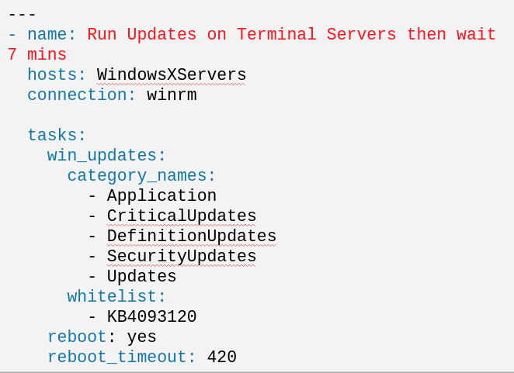
Notes:
Playbook example:
The name fields are human-readable comments. Optional, but useful as comments to the Playbook. These strings also show up in Tower, so it is easy to correlate any failures in a long running Playbook.
Inventory call-out
Variables can be handled in several different ways:
Directly in the playbook
As part of a separate vars file
Via the command line
As output from a previous play
Via Tower
You are not required to use root as the remote user. You can have Ansible connect and run the playbook as any user or even multiple users – as long as that user has the permission to perform the tasks in the playbook. You can even use multiple users and specify different users for different plays or tasks.
Ansible supports sudo, su, powerbroker, and other privilege escalation mechanisms.
The real work. General format:
<<module>>: key=value

Slide 14
Red Hat Ansible Tower:
Operate and control at scale
Notes:
Control, Knowledge, Delegation
RBAC
Push button deployment (Delegation)
Centralized logging (auditing, compliance)
RESTful API
Role-based access control keeps environments secure, and teams efficient
Non-privileged users can safely deploy entire applications with push-button deployment access
All Ansible automations are centrally logged, ensuring complete auditability and compliance
Centralize and control your IT infrastructure with a visual dashboard, role-based access control, job scheduling, integrated notifications and graphical inventory management.

Slide 15
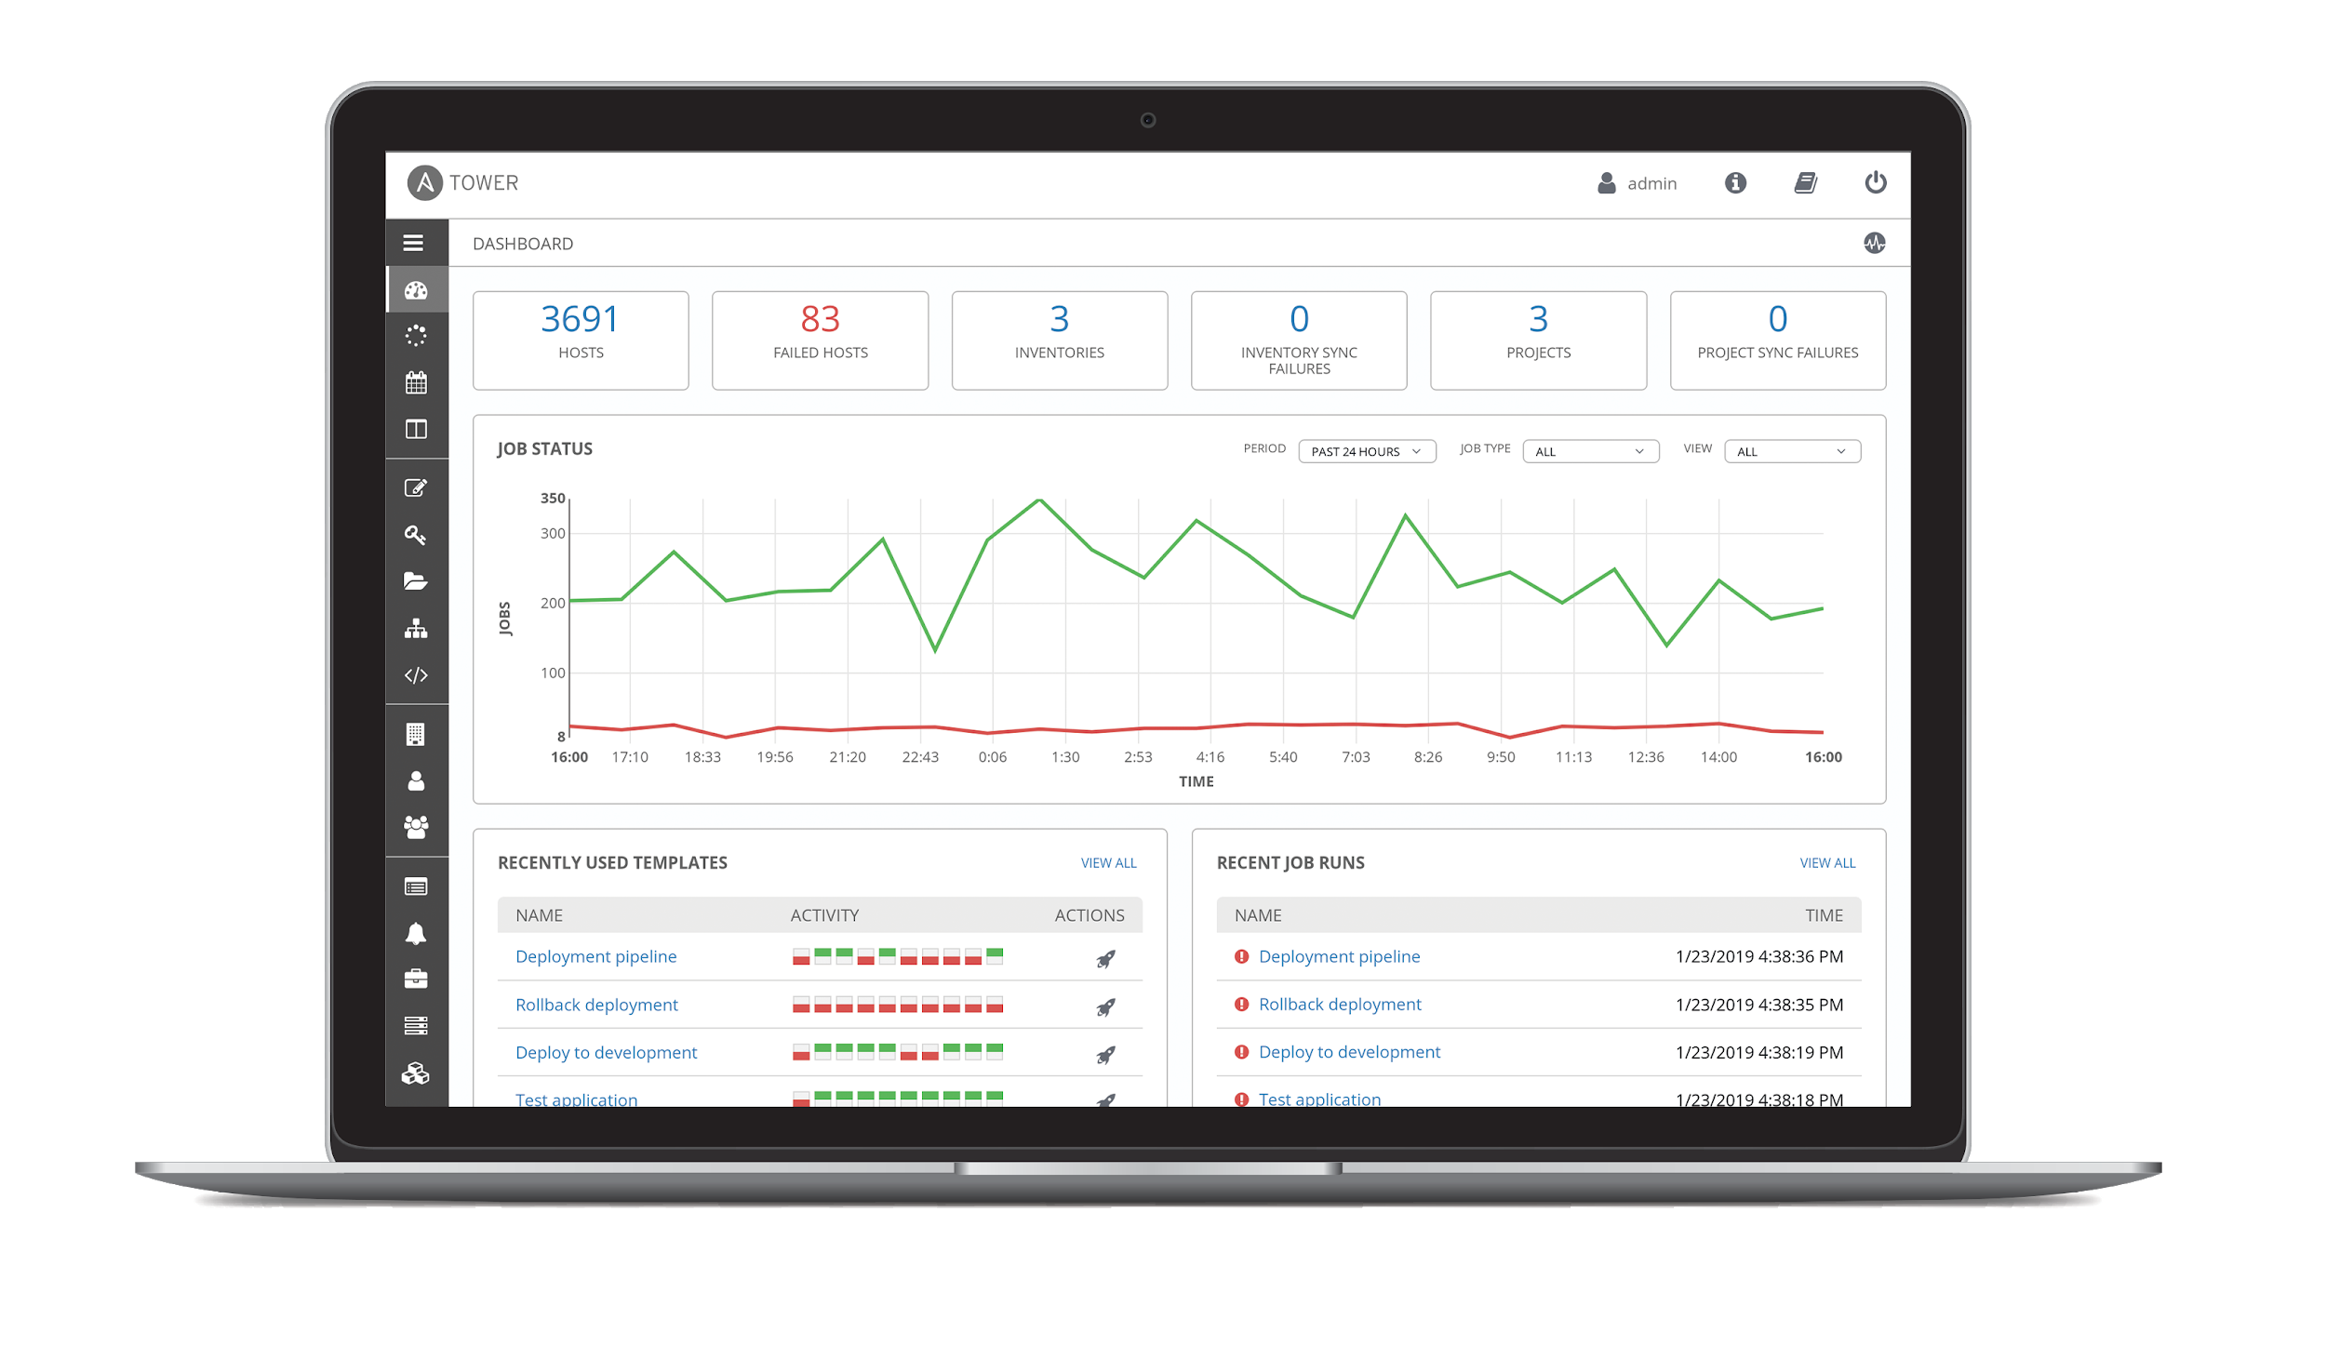
What is Ansible Tower?
Ansible Tower is a UI and RESTful API allowing you to scale IT automation, manage complex deployments and speed productivity.
• Role-based access control
• Deploy entire applications with push-button deployment access
• All automations are centrally logged
• Powerful workflows match your IT processes
Notes:
Control, Knowledge, Delegation
When more than one person is running the same playbook in the organization, Ansible Tower is valuable.
RBAC
Push button deployment (Delegation)
Centralized logging (auditing, compliance)
RESTful API
Role-based access control keeps environments secure, and teams efficient
Non-privileged users can safely deploy entire applications with push-button deployment access
All Ansible automations are centrally logged, ensuring complete auditability and compliance
Centralize and control your IT infrastructure with a visual dashboard, role-based access control, job scheduling, integrated notifications and graphical inventory management.

Slide 16











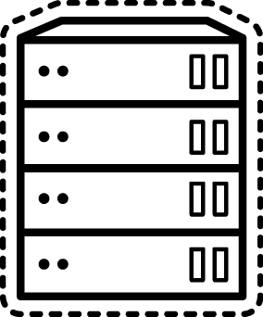


ANSIBLE TOWER INTEGRATIONS
Client accessing Ansible Tower
CMDB
Postgre5QL
MANAGED HOSTS
DOMAIN CONTROLLER
Notes:
‹#›

Slide 17
Red Hat Ansible Automation Platform
Network
Lines of business
Security
Operations
Infrastructure
Developers
Engage
Knowledge
Automation Analytics
Collaborate
Automation Hub
Trusted
Certified content
Accelerate
Collections
Scale
Ansible Tower: Operate & control at scale
Create
Ansible Engine: Universal language of automation
Fueled by an open source community
Notes:
Ansible Automation is the enterprise framework for automating across IT operations.
Ansible Engine runs Ansible Playbooks, the automation language that can perfectly describe an IT application infrastructure.
Ansible Tower allows you scale IT automation, manage complex deployments and speed productivity.
Ansible is the Lingua Franca of the enterprise
It empowers development to production, from IT to the business
----------------------------------------------------------------
Points Tim Yeaton added here in his delivery:
memorialize/institutionalize in the Playbook
Standardize on Ansible
You need a language to help articulate the workflow all they way through live production
Use a language to communicate and facilitate between dev and ops
Becomes fact based or system of record once written in a Playbook

Slide 18



Automation Analytics: What is it?
SaaS (Software as a Service) on cloud.redhat.com
Analytics for all Ansible Tower clusters for an organization
Includes:
• visual dashboard
• health notifications
• organization statistics
Notes:
Workflows allow you to configure a sequence of disparate job templates (or workflow templates). Job or workflow templates are linked together using a graph-like structure called nodes. These nodes can be jobs, project syncs, or inventory syncs. A template can be part of different workflows or used multiple times in the same workflow.

Slide 19

Automation Analytics: What does it provide?
Enables an Automation Center of Excellence
View information about automation health, usage and performance across your enterprise.
Gain information about automation in your enterprise:
Which organizations are using the most automation?
Utilization rates
Enterprise-wide success and failure rates for automation
Notes:
Workflows allow you to configure a sequence of disparate job templates (or workflow templates). Job or workflow templates are linked together using a graph-like structure called nodes. These nodes can be jobs, project syncs, or inventory syncs. A template can be part of different workflows or used multiple times in the same workflow.

Slide 20
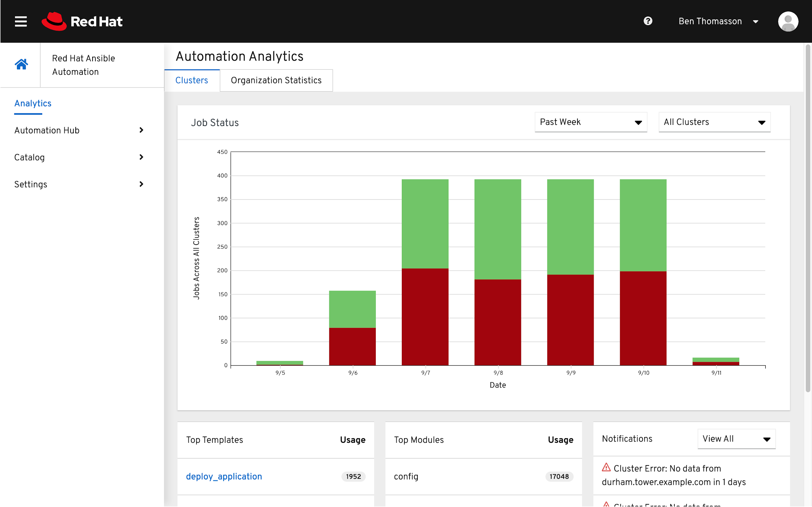
Analytics dashboard
Information across all clusters for an enterprise:
Job Status graph
Top Job Templates
Top Modules
Notes:
Workflows allow you to configure a sequence of disparate job templates (or workflow templates). Job or workflow templates are linked together using a graph-like structure called nodes. These nodes can be jobs, project syncs, or inventory syncs. A template can be part of different workflows or used multiple times in the same workflow.

Slide 21
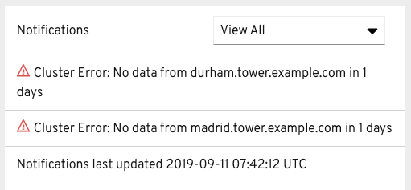
Health notifications
Ansible Tower Cluster is down
Node (within a cluster) is down
Last time data was updated
Near license count
Notes:
Workflows allow you to configure a sequence of disparate job templates (or workflow templates). Job or workflow templates are linked together using a graph-like structure called nodes. These nodes can be jobs, project syncs, or inventory syncs. A template can be part of different workflows or used multiple times in the same workflow.

Slide 22
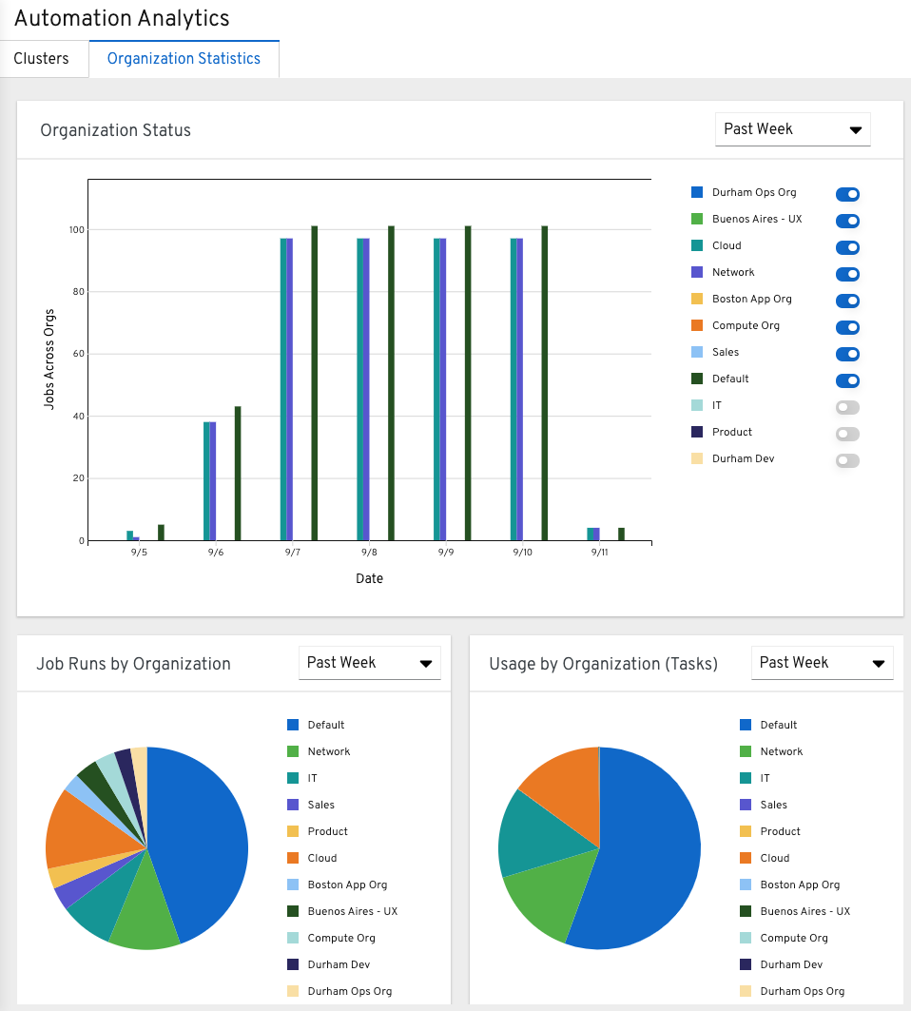
Organizational statistics
Filter by Organization
Job Status by Organization
Usage by Organization
Job Runs by Organization
Notes:
Organizational statistics allows a customer to see Ansible consumption across an enterprise. If one organization starts producing Ansible Job Templates and shares them across their company, data is aggregated and presented in a visual format to show trends over time. This data can be filters by organization, and filtered over time to present usual data to compare organizations against each other. What we saw with several large customers was that they wanted to be able to measure success and were starting to aggregate this data manually anyway, so we want to make this process more turn-key and easy for all customers to help give them the ability to measure success.

Slide 23
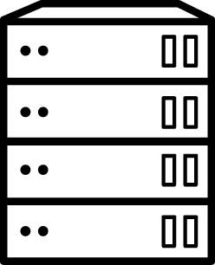

Dashboard comparison
Ansible Tower
Automation Analytics
• Top job templates
Top modules
• All clusters • Filter by cluster
• Recent job templates • No module data
• One cluster
Notes:
Organizational statistics allows a customer to see Ansible consumption across an enterprise. If one organization starts producing Ansible Job Templates and shares them across their company, data is aggregated and presented in a visual format to show trends over time. This data can be filters by organization, and filtered over time to present usual data to compare organizations against each other. What we saw with several large customers was that they wanted to be able to measure success and were starting to aggregate this data manually anyway, so we want to make this process more turn-key and easy for all customers to help give them the ability to measure success.

Slide 24


Ansible Content Collections
Simplified and consistent content delivery
Provides quick benefit by lowering barriers to automation
Streamlines tech partners providing direct-to-user automation
Simplifies internal collaboration, distribution, versioning
Ability to distribute, share and consume content at your own pace
Notes:
Workflows allow you to configure a sequence of disparate job templates (or workflow templates). Job or workflow templates are linked together using a graph-like structure called nodes. These nodes can be jobs, project syncs, or inventory syncs. A template can be part of different workflows or used multiple times in the same workflow.

Slide 25
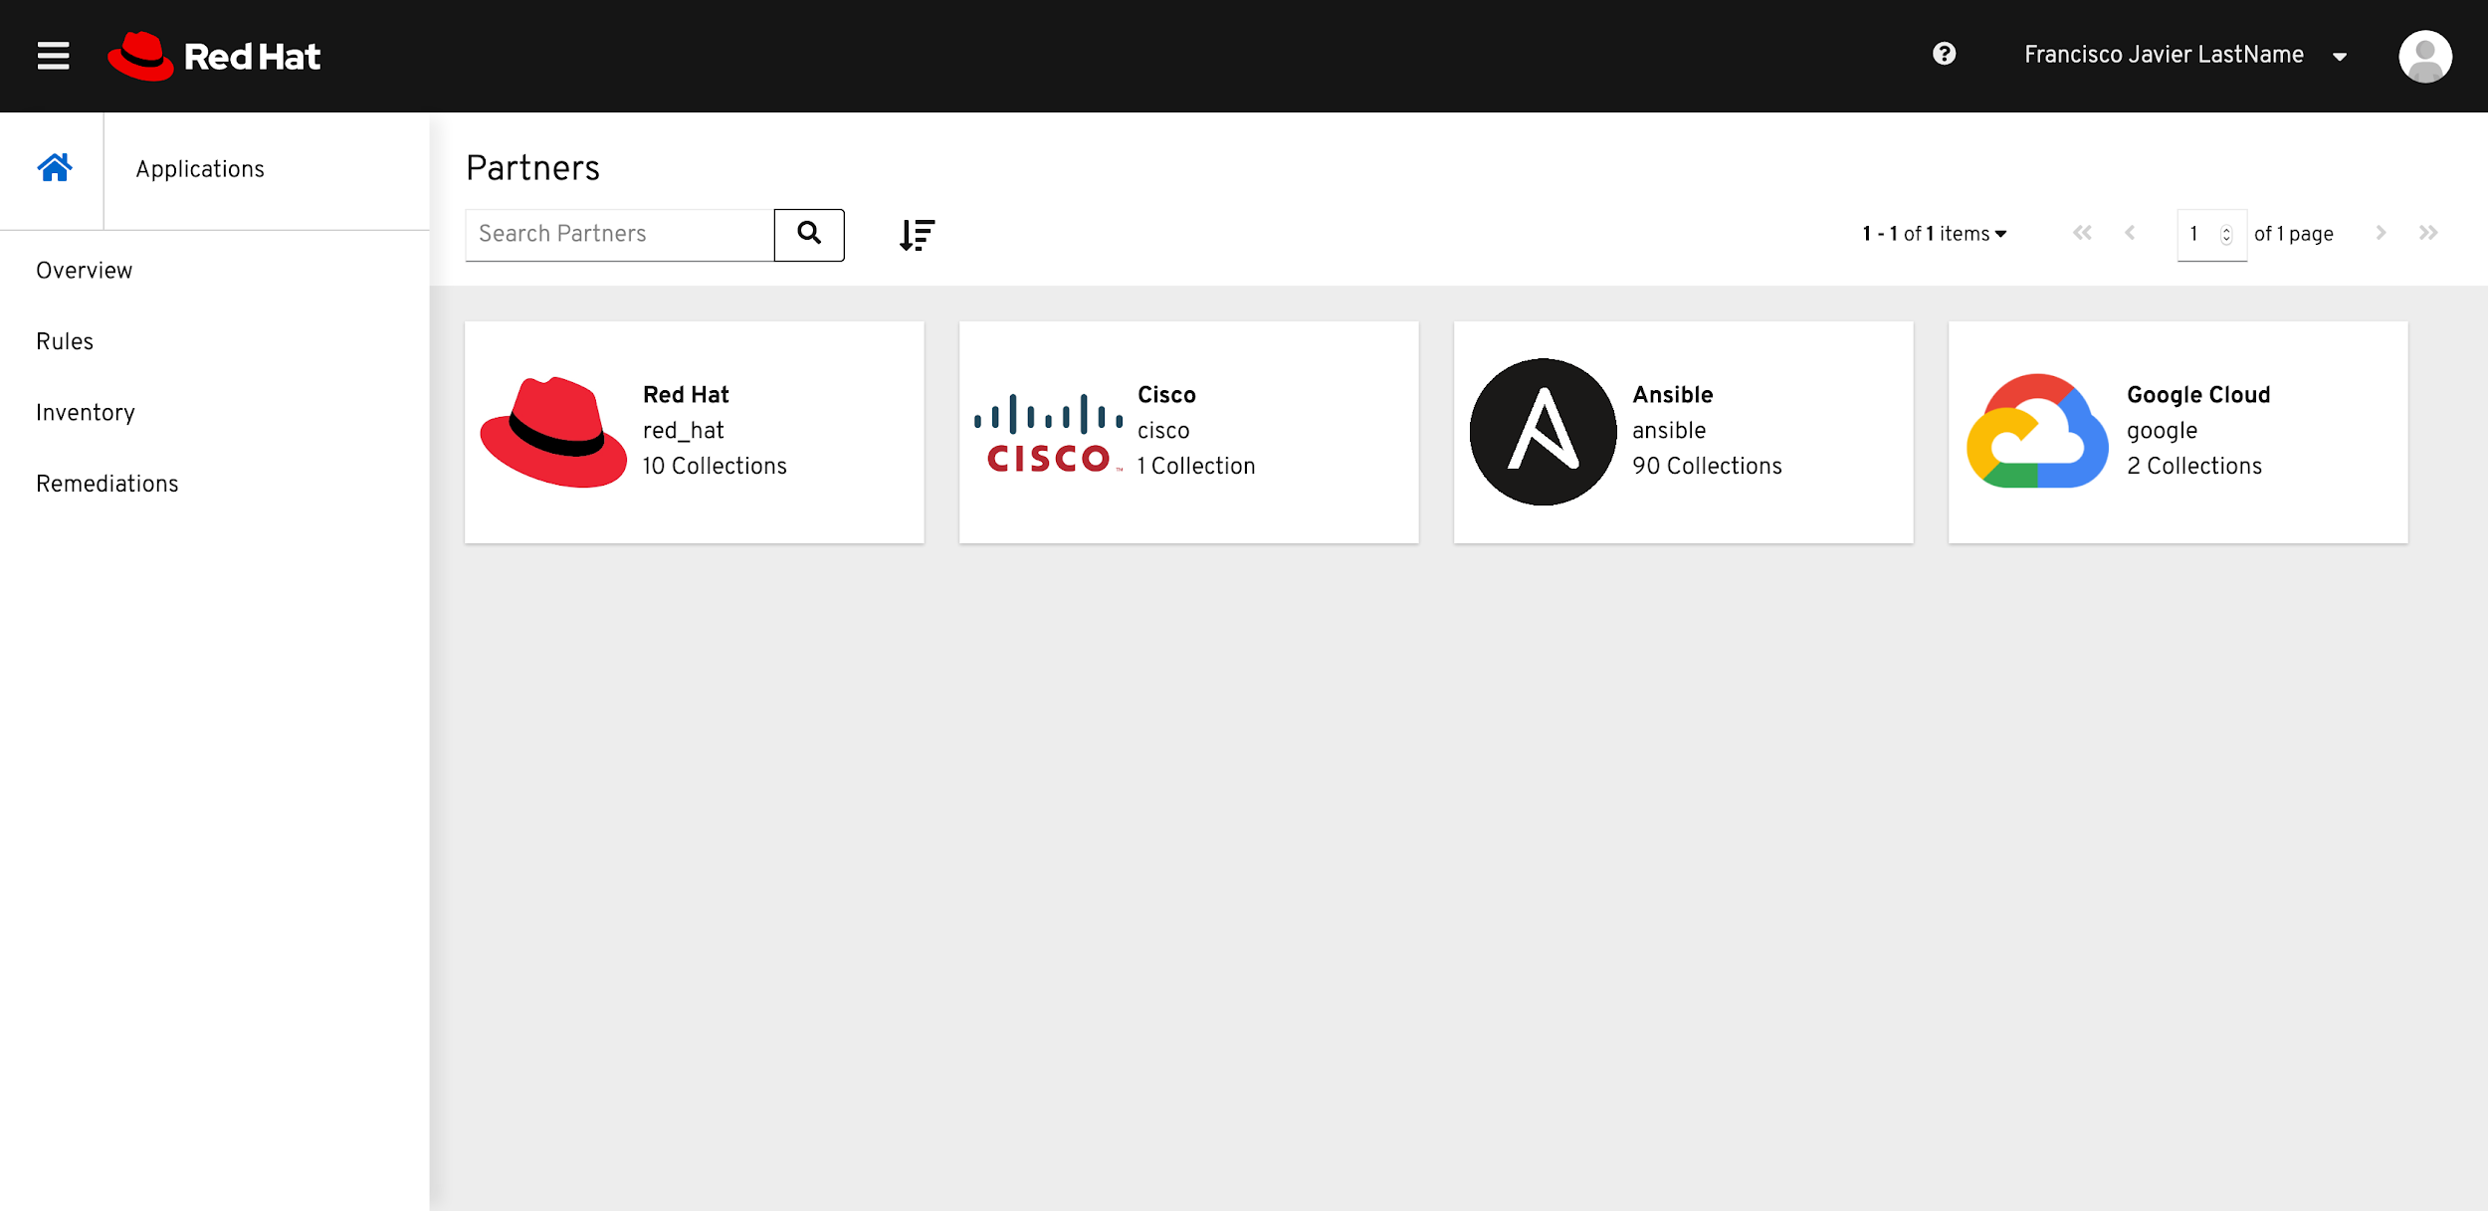
Automation Hub
Discover, publish, and manage Collections
Quickly discover available Red Hat and certified content through Collections.
Manage and test your organization’s view of available content.*
Manage your locally available automation via on-premise.*
Notes:
Workflows allow you to configure a sequence of disparate job templates (or workflow templates). Job or workflow templates are linked together using a graph-like structure called nodes. These nodes can be jobs, project syncs, or inventory syncs. A template can be part of different workflows or used multiple times in the same workflow.

Slide 26



AUTOMATION ACROSS
THE ENTERPRISE
Notes:
Control, Knowledge, Delegation
RBAC
Push button deployment (Delegation)
Centralized logging (auditing, compliance)
RESTful API
Role-based access control keeps environments secure, and teams efficient
Non-privileged users can safely deploy entire applications with push-button deployment access
All Ansible automations are centrally logged, ensuring complete auditability and compliance
Centralize and control your IT infrastructure with a visual dashboard, role-based access control, job scheduling, integrated notifications and graphical inventory management.

Slide 27
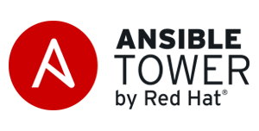
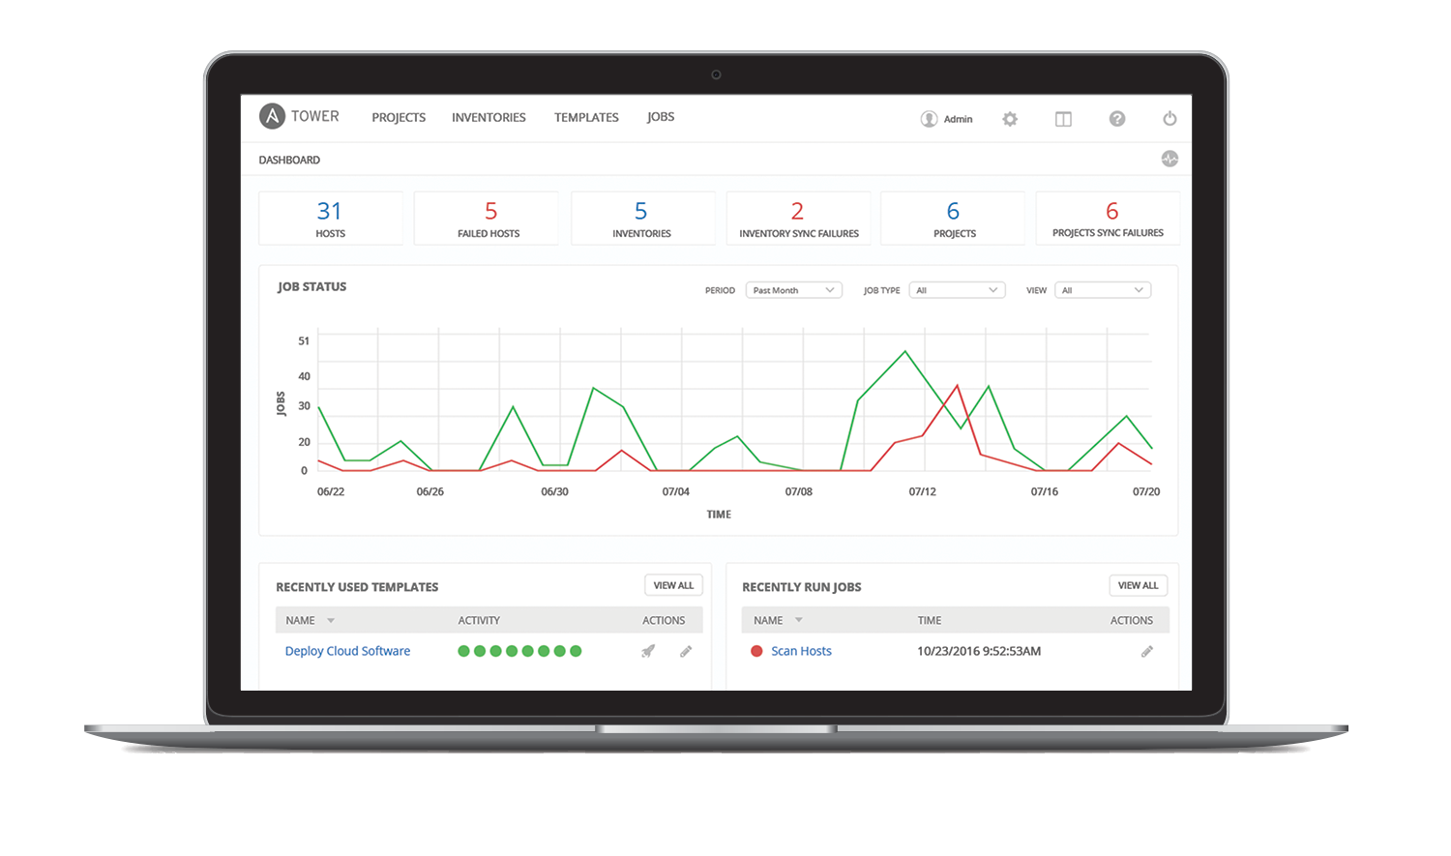
Ansible Tower is an enterprise framework for controlling, securing and managing your Ansible automation – with a UI and RESTful API.
RESTful API
Role Based access control
Deploy entire applications with push-button deployment access
All automations are centrally logged
Notes:
For servers and switches alike
choose your data source (CMDB, etc)
Automatic discovery of hardware in parallel
Compare running configs to golden masters on schedules
“Team A can touch the access ports, but they can’t touch the trunk ports.”
-Bootstrap: Trigger device config jobs post Zero Touch Provisioning
‹#›

Slide 28
Automation for Teams
Ansible Tower technical introduction and overview
Notes:
‹#›

Slide 29


RED HAT ANSIBLE TOWER
Scale + operationalize your automation
CONTROL
KNOWLEDGE
DELEGATION
RED HAT ANSIBLE ENGINE
Support for your Ansible automation
SIMPLE
POWERFUL
AGENTLESS
FUELED BY AN INNOVATIVE OPEN SOURCE COMMUNITY
‹#›
Notes:
‹#›

Slide 30







….
ANSIBLE CLI & CI SYSTEMS
ADMINS
ANSIBLE PLAYBOOKS
ANSIBLE TOWER
ROLE-BASED ACCESS CONTROL
KNOWLEDGE & VISIBILITY
SCHEDULED & CENTRALIZED JOBS
SIMPLE USER INTERFACE
TOWER API
USERS
ANSIBLE
ENGINE
OPEN SOURCE MODULE LIBRARY
PLUGINS
PYTHON CODEBASE
TRANSPORT SSH, WINRM, ETC.
AUTOMATE YOUR ENTERPRISE
INFRASTRUCTURE
LINUX, WINDOWS,
UNIX …
NETWORKS
ARISTA, CISCO, JUNIPER …
CONTAINERS
DOCKER,
LXC …
CLOUD
AWS, GOOGLE CLOUD, AZURE …
SERVICES
DATABASES,
LOGGING, SOURCE CONTROL MANAGEMENT…
USE CASES
PROVISIONING
CONFIGURATION
MANAGEMENT
APP DEPLOYMENT
CONTINUOUS DELIVERY
SECURITY & COMPLIANCE
ORCHESTRATION
Notes:
‹#›

Slide 31
ANSIBLE TOWER INTEGRATIONS
Client accessing Ansible Tower
CMDB
Postgre5QL
MANAGED HOSTS
DOMAIN CONTROLLER
Notes:
‹#›

Slide 32
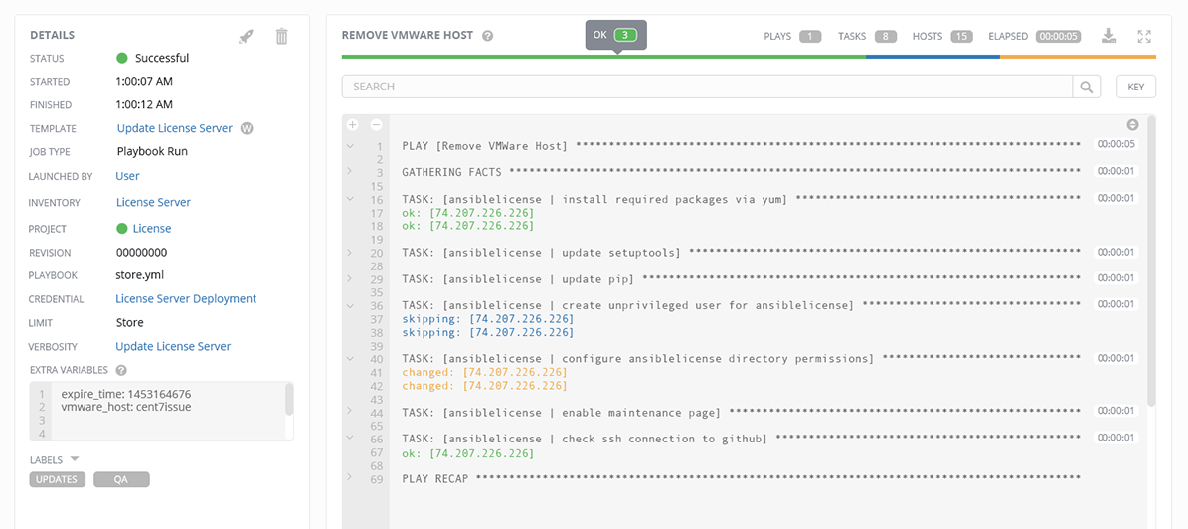
Ansible Tower
Job Status Update
Heads-up NOC-style automation dashboard displays everything going on in your Ansible environment.
‹#›
Notes:
‹#›

Slide 33
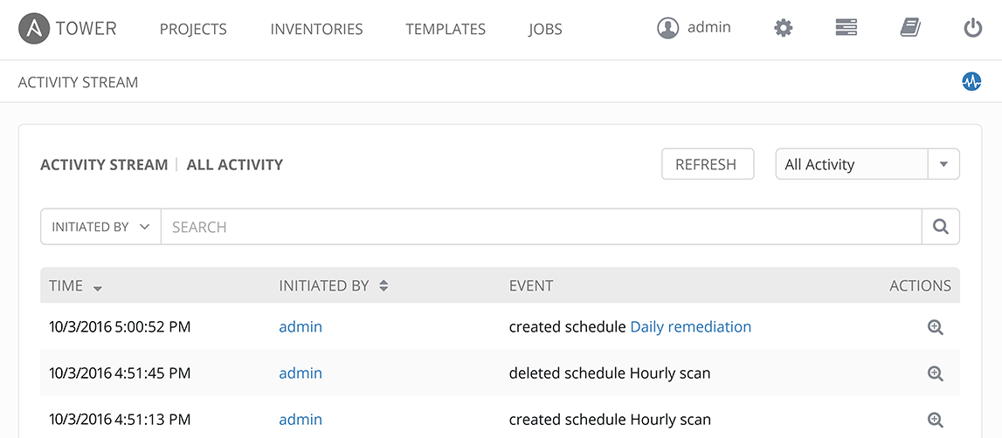
Ansible Tower
Activity Stream
Securely stores every Job that runs, and enables you to view them later, or export details through Tower’s API.
‹#›
Notes:
‹#›

Slide 34
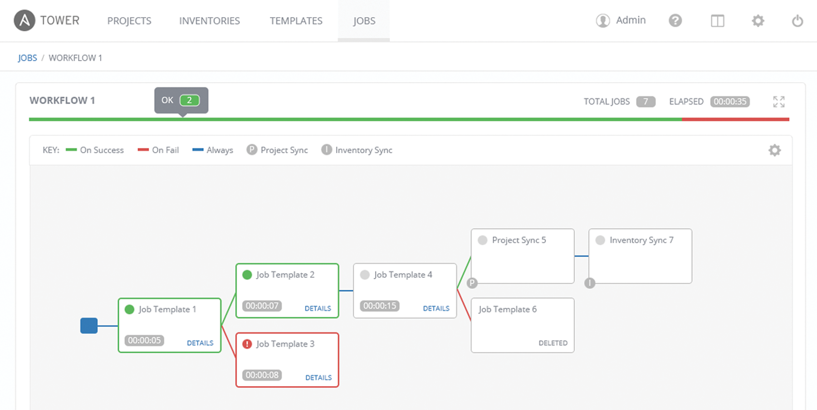
Ansible Tower
Multi-Playbook Workflows
Tower’s multi-Playbook workflows chains any number of Playbooks together to create a single workflow. Different Jobs can be run depending on success or failure of the prior Playbook.
‹#›
Notes:
‹#›

Slide 35
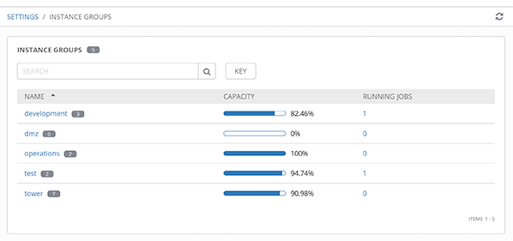
Ansible Tower
Scale-Out Clustering
Connect multiple Tower nodes into a Tower cluster to add redundancy and capacity to your automation platform.
Add reserved capacity and capacity by organization, and deploy remote execution nodes for additional local capacity.
‹#›
Notes:
‹#›

Slide 36
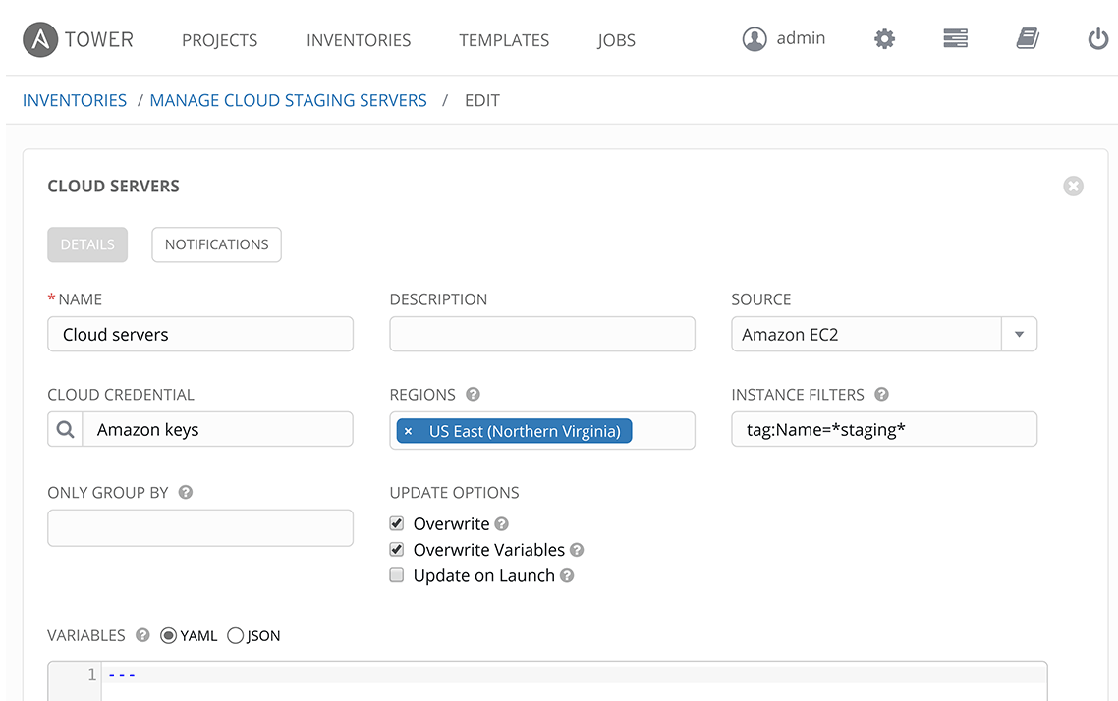
Ansible Tower
Manage and Track Your Inventory
Tower’s inventory syncing and provisioning callbacks allow nodes to request configuration on demand, enabling autoscaling.
Smart Inventories allow you to organize and automate hosts across all your providers based on a powerful host fact query engine.
See alerts from Red Hat Insights directly from Tower, and use Insights-provided Playbook Remediation to fix issues in your infrastructure.
‹#›
Notes:
‹#›

Slide 37
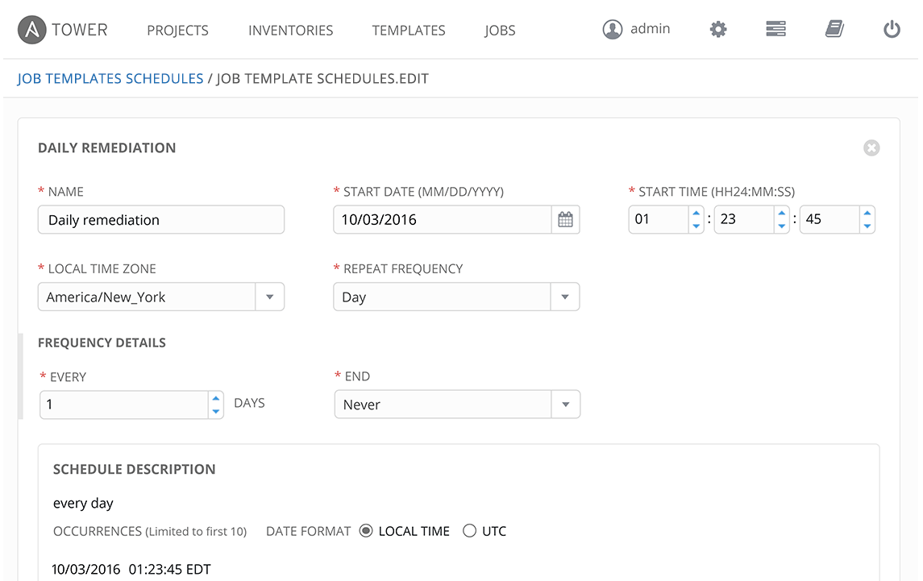
Ansible Tower
Schedule Jobs
Enables you to schedule any Job now, later, or forever.
‹#›
Notes:
‹#›

Slide 38
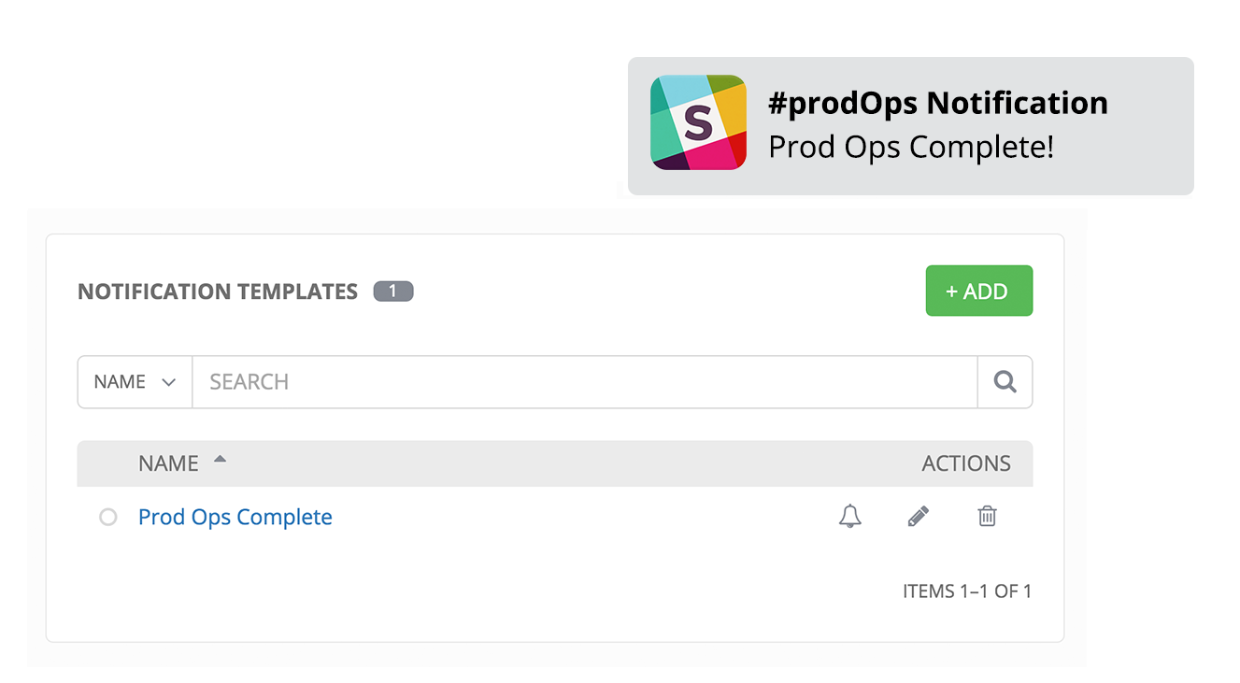
Ansible Tower
Integrated Notifications
Stay informed of your automation status via integrated notifications. Connect Slack, Hipchat, SMS, email and more.
‹#›
Notes:
‹#›

Slide 39
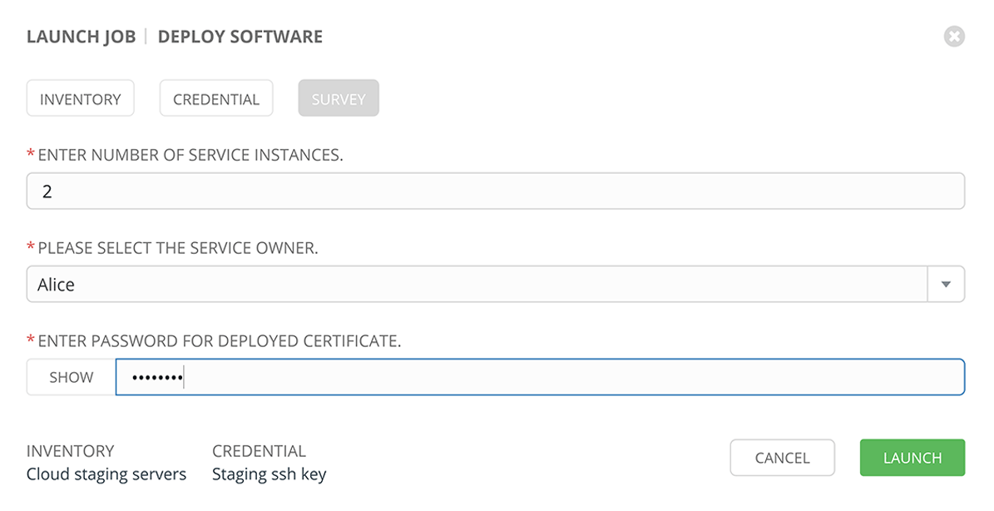
Ansible Tower
Self-Service IT
Tower lets you launch Playbooks with just a single click. It can prompt you for variables, let you choose from available secure credentials and monitor the resulting deployments.
‹#›
Notes:
‹#›

Slide 40
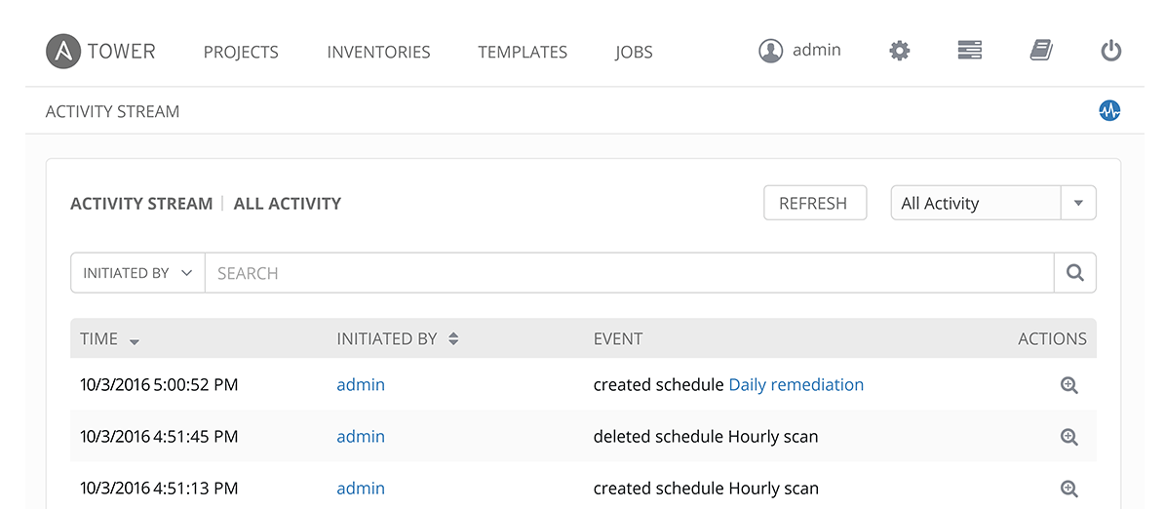
Ansible Tower
External Logging
Connect Tower to your external logging and analytics provider to perform analysis of automation and event correlation across your entire environment.
‹#›
Notes:
‹#›

Slide 41

What Happens Next
Use Cases

Slide 42



Automating Complex Tasks
Automate the deployment of the individual components as a workflow.
Make that workflow available to operators.
Force changes to workflow to maintain compliance
Run that workflow on a regular bases to detect any deviation from the original deployment.
Routing/
Peering
Firewall Context
SVIs
VLANs
‹#›
Notes:
‹#›

Slide 43

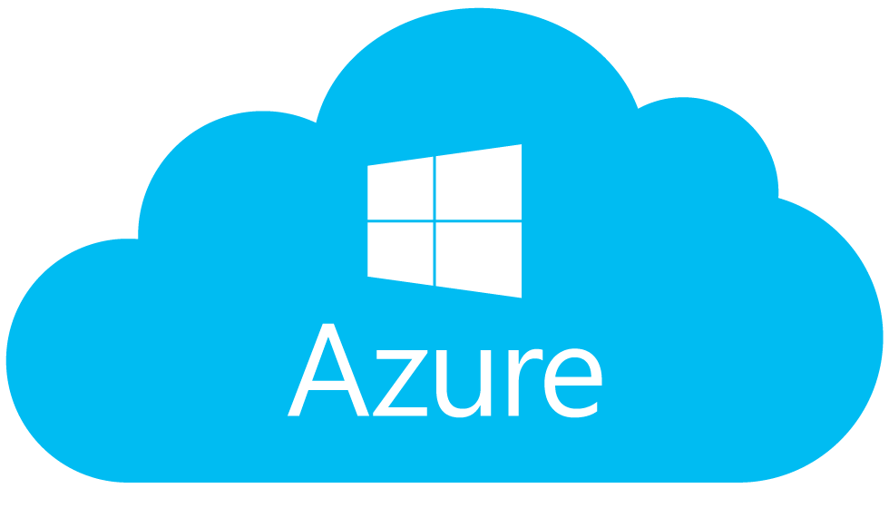

Hybrid Cloud
VPC
Resource Group
Automate the creation of the VPC and network components.
Deploy the same routers, load-balancers, and firewalls that you use on-site.
Automate the entire network in a uniform way.
Host
Host
‹#›
Notes:
‹#›

Slide 44


Workflow Automation
Customer makes request from the service catalog
Request goes through approval process
Service catalog calls Tower API to fulfill request
Ansible Tower updates ticket
Network
‹#›
Notes:
‹#›

Slide 45



Tier 1 Support Automation
Monitoring/Logging Platform detects event and calls the Ansible Tower API
Ansible Tower runs a playbook to collect event-specific information
Ansible Tower runs a playbook to open a support ticket and/or notify Tier 2 support
Send Notification/
Open Ticket
Collect Data
Network
‹#›
Notes:
‹#›

Slide 46
Automated Security & HIPAA Compliance
Business Drivers
Industry standards based compliance - OpenSCAP, NIST, and HIPAA
Continuous scanning and remediation to remain in compliance with regulation; prevent cyber threats
Real time configuration and drift management
Simplify and speed up response to audits
AUTOMATED SECURITY & HIPAA COMPLIANCE
Technical Requirements
Consistent and verifiable enforcement policies
Compliance awareness and transparency
Reduced probability of human error and analysis time
Compliance as code
Simplified reporting
Automation
Red Hat Technology:
RHEL
Satellite
Insights
Ansible Automation
‹#›

Slide 47
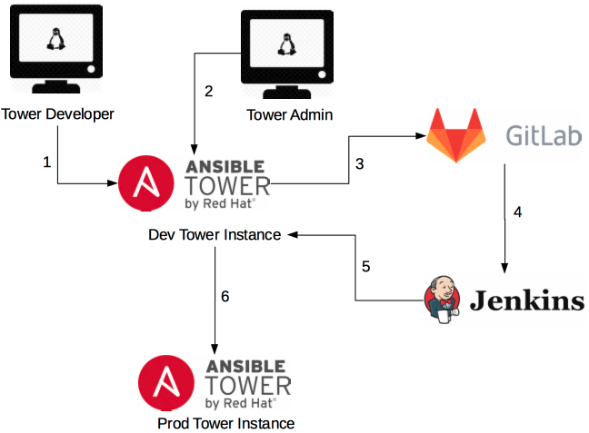
CICD for App Dev, Testing, Capacity/Performance (EAP & WAS)
Notes:
1. A Tower developer builds or modifies an asset in the dev version of Tower.
2. A Tower administrator runs a job telling dev Tower to export its assets.
3. The job commits the files into an SCM
4. The SCM notifies a CI tool (or the CI tool polls the SCM)
5. The CI tool calls to the import job on the Dev Tower instance
6. The job on the Dev Tower instance calls to the Prod Tower instance to update its assets.690317

Slide 48
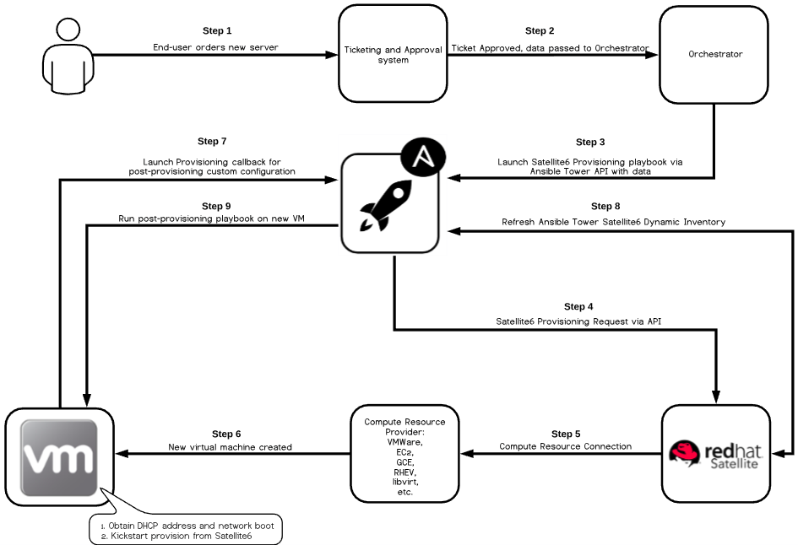
Automated Virtual Host Provisioning
Notes:
1. A Tower developer builds or modifies an asset in the dev version of Tower.
2. A Tower administrator runs a job telling dev Tower to export its assets.
3. The job commits the files into an SCM
4. The SCM notifies a CI tool (or the CI tool polls the SCM)
5. The CI tool calls to the import job on the Dev Tower instance
6. The job on the Dev Tower instance calls to the Prod Tower instance to update its assets.690317

Slide 49

Additional Resources
Red Hat Resources
https://github.com/ansible/workshops
https://www.Ansible.com/
http://docs.Ansible.com/
Microsoft Azure
https://docs.microsoft.com/en-us/azure/developer/ansible/
Redhat Education
http://redhatgov.io/
https://learn.openshift.com
http://lab.redhat.com
https://www.ansible.com/resources/ebooks
https://redhatdemos.com/
GitHub Shadd Gallegos
https://github.com/ShaddGallegos/RHTI
https://github.com/ShaddGallegos/RHTI/raw/master/Ansible_Tower/Ansible_Use_Cases/Ansible%20Use%20Case%20List.xlsx

Slide 50
THANK YOU
plus.google.com/+RedHat
facebook.com/redhatinc
linkedin.com/company/red-hat
twitter.com/RedHatNews
youtube.com/user/RedHatVideos

